Slide 1
CH 3
Queue

Slide 2
Queue
Definition
A Queue is an ordered collection of items from which items may be deleted at one end (called the front of the queue) and into which items may be inserted at the other end (the rear of the queue).
The first element inserted into the queue is the first element to be removed.
For this reason a queue is sometimes called a fifo (first-in first-out) list as opposed to the stack, which is a lifo (last-in first-out).
The process of inserting an item to queue is called Enqueue and the process of removing an item from the queue is called Dequeue.

Slide 3
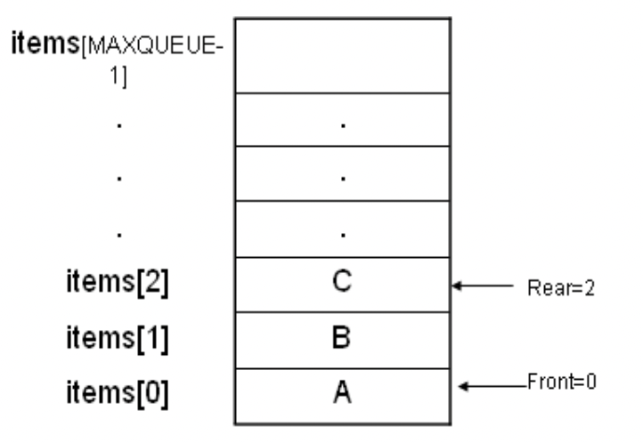
Queue

Slide 4
Operations on queue
MakeEmpty(q): To make q as an empty queue
Enqueue(q, x): To insert an item x at the rear of the queue, this is also called by names add, insert.
Dequeue(q): To delete an item from the front of the queue q. this is also known as Delete, Remove.
IsFull(q): To check whether the queue q is full.
IsEmpty(q): To check whether the queue q is empty
Traverse (q): To read entire queue that is display the content of the queue.

Slide 5
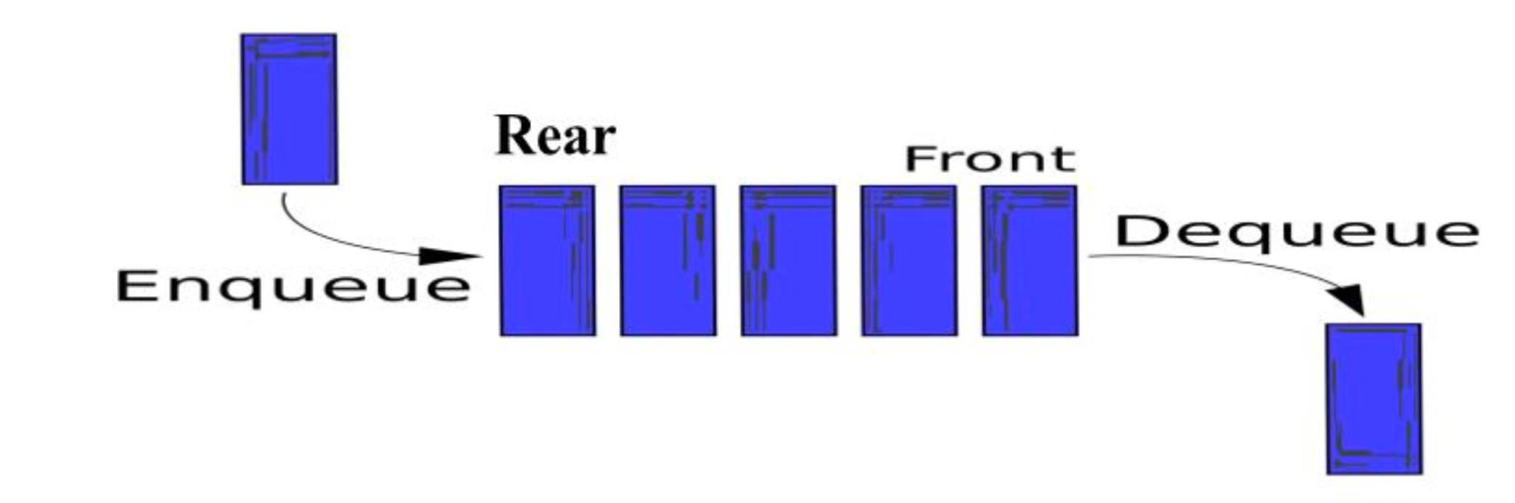
Operation on queue

Slide 6
Queue as an ADT
A queue q of type T is a finite sequence of elements with the operations:
MakeEmpty(q): To make q as an empty queue
Enqueue(q, x): To insert an item x at the rear of the queue, this is also called by names add, insert.
Dequeue(q): To delete an item from the front of the queue q. this is also known as Delete, Remove.
IsFull(q): To check whether the queue q is full.
IsEmpty(q): To check whether the queue q is empty
Traverse (q): To read entire queue that is display the content of the queue.

Slide 7
Implementation of queue
There are two techniques for implementing the queue:
Array implementation of queue(static memory allocation)
Linked list implementation of queue(dynamic memory allocation)

Slide 8
Static Implementation
# define MAXQUEUE /* size of the queue items*/
struct queue {
int front;
int rear;
int items[MAXQUEUE];
};
typedef struct queue qt;

Slide 9
Static Implementation [2]
Algorithm MakeEmpty(q):
Start
Initialize front and rear of q as: q->rear = -1 q->front = 0
Stop
void makeEmpty(qt *q)
{
q->rear=-1;
q->front=0;
}

Slide 10
Static Implementation [3]
Algorithm isEmpty(q):
Start
Check the rear and front as: If rear < front, then display empty Else display not empty
Stop
int IsEmpty(qt *q)
{
if(q->rear < q->front)
return 1;
else
return 0;
}

Slide 11
Static Implementation [4]
Algorithm isFull(q):
Start
Check if rear is equal to max size: If rear == MAXSIZE -1, then display full Else display not full
Stop
int IsFull(qt *q)
{
if(q->rear==MAXQUEUEZIZE-1)
return 1; else
return 0;
}

Slide 12
Static Implementation [5]
Algorithm Enqueue(q,x):
Start
Check if queue is full, if not go to step 3, Else go to step 5:
Increment rear: rear++;
Insert x into q->items[rear]
Stop

Slide 13
Static Implementation [5]
Algorithm Dequeue(q):
Start
Check if queue is empty, if not go to step 3, Else go to step 5:
Read from q->items[front]
Increment front.
Stop

Slide 14
Problems with linear queue
Both rear and front indices are increased but never decreased.
As items are removed from the queue, the storage space at the beginning of the array is discarded and never used again.
Wastage of the space is the main problem with linear queue.

Slide 15
Dynamic Implementation[1]
Circular Queue
A queue where the start and end of the queue are joined together.
A circular queue overcomes the problem of unutilized space in linear queue implementation as array.
A circular queue is one in which the insertion of a new element is done at very first location of the queue if the last location of the queue is full.
It is also called Ring Buffer.
In circular queue we sacrifice one element of the array. Thus to insert n elements in a circular queue we need an array of size n+1.(or we can insert one less than the size of the array in circular queue).

Slide 16
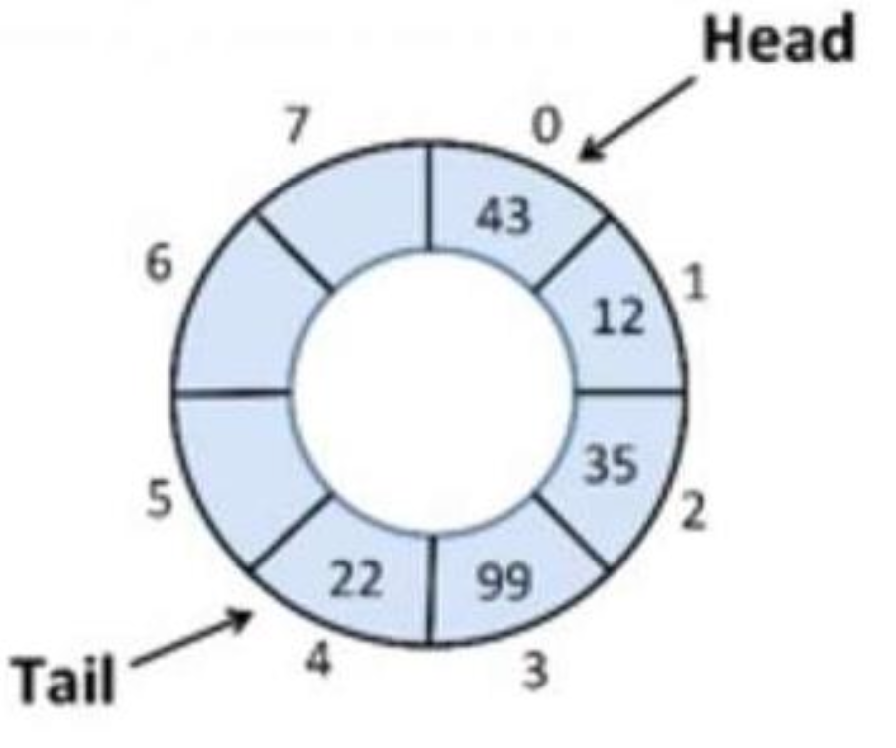
Dynamic Implementation[2]
Declaration of a Circular Queue:
# define MAXSIZE 50 /* size of the circular queue items*/
Struct cqueue{ int front; int rear; int items[MAXSIZE]; };
typedef struct cqueue cq;
Initialization of Circular queue: rear=front=MAXSIZE-1

Slide 17
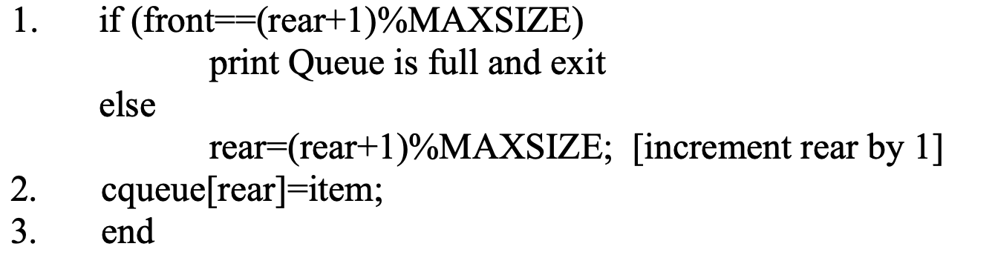
Dynamic Implementation[3]
Algorithm for Inserting an element in a circular queue:

Slide 18
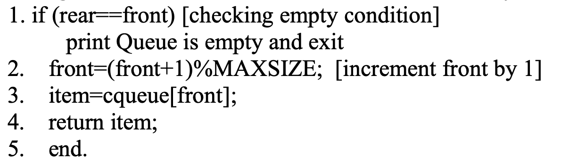
Dynamic Implementation[4]
Algorithm for Deleting an element in a circular queue:
This algorithm assumes that rear and front are initially set to MAZSIZE-1.

Slide 19
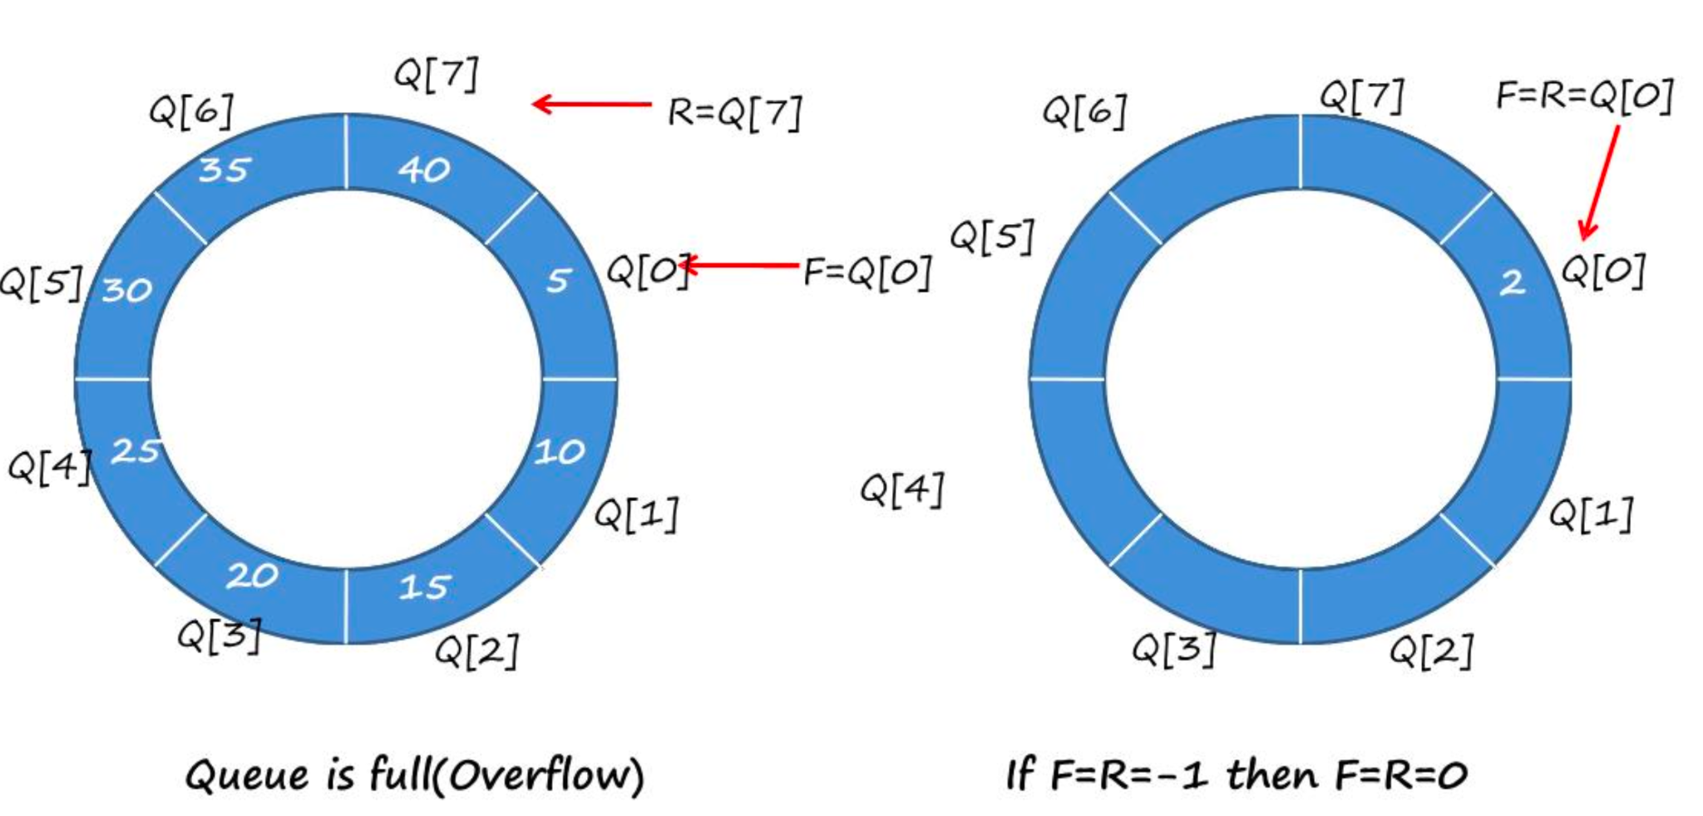
Dynamic Implementation[5]

Slide 20
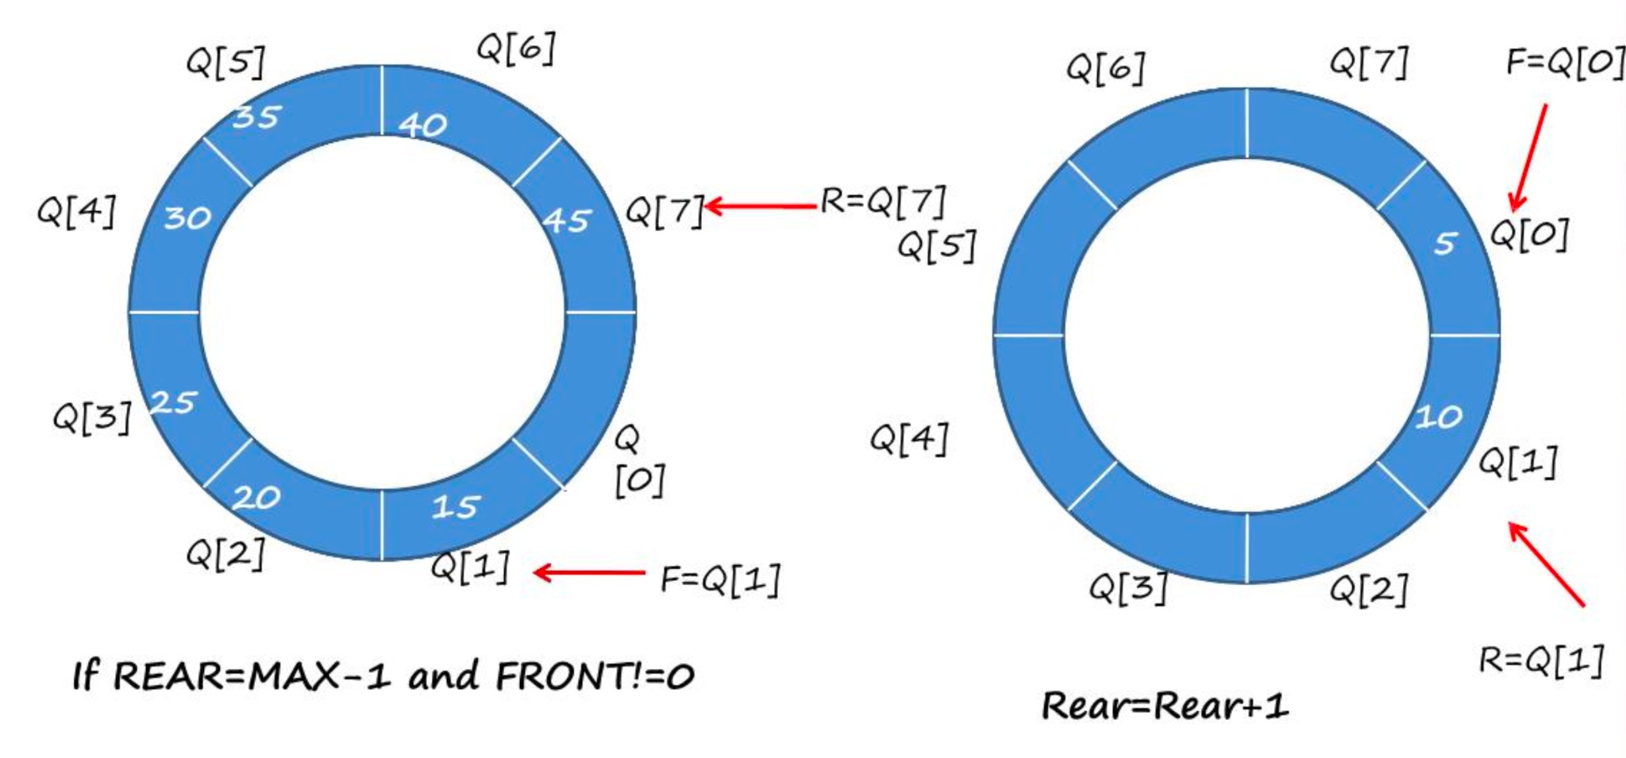
Dynamic Implementation[6]

Slide 21
Priority Queue
A priority queue is a collection of elements such that each element has been assigned a priority and the order in which elements are deleted and processed comes from the following rules:.
An element of higher priority is processed before any element of lower priority.
If two elements has same priority then they are processed according to the order in which they were added to the queue.
The best application of priority queue is observed in CPU scheduling.
The jobs which have higher priority are processed first.
If the priority of two jobs is same this jobs are processed according to their position in queue.
A short job is given higher priority over the longer one.

Slide 22
Priority Queue Types
Ascending priority queue(min priority queue):
An ascending priority queue is a collection of items into which items can be inserted arbitrarily but from which only the smallest item can be removed.
Descending priority queue(max priority queue):
A descending priority queue is a collection of items into which items can be inserted arbitrarily but from which only the largest item can be removed.

Slide 23
Priority Queue ADT
A ascending priority queue of elements of type T is a finite sequence of elements of T together with the operations:
MakeEmpty(p): Create an empty priority queue p
Empty(p): Determine if the priority queue p is empty or not
Insert(p,x): Add element x on the priority queue p
DeleteMin(p): If the priority queue p is not empty, remove the minimum element of the queue and return it.
FindMin(p): Retrieve the minimum element of the priority queue p.

Slide 24
Array implementation of priority queue:
Unordered array implementation:
To insert an item, insert it at the rear end of the queue.
To delete an item, find the position of the minimum element and
Either mark it as deleted (lazy deletion) or
Shift all elements past the deleted element by one position and then decrement rear.

Slide 25
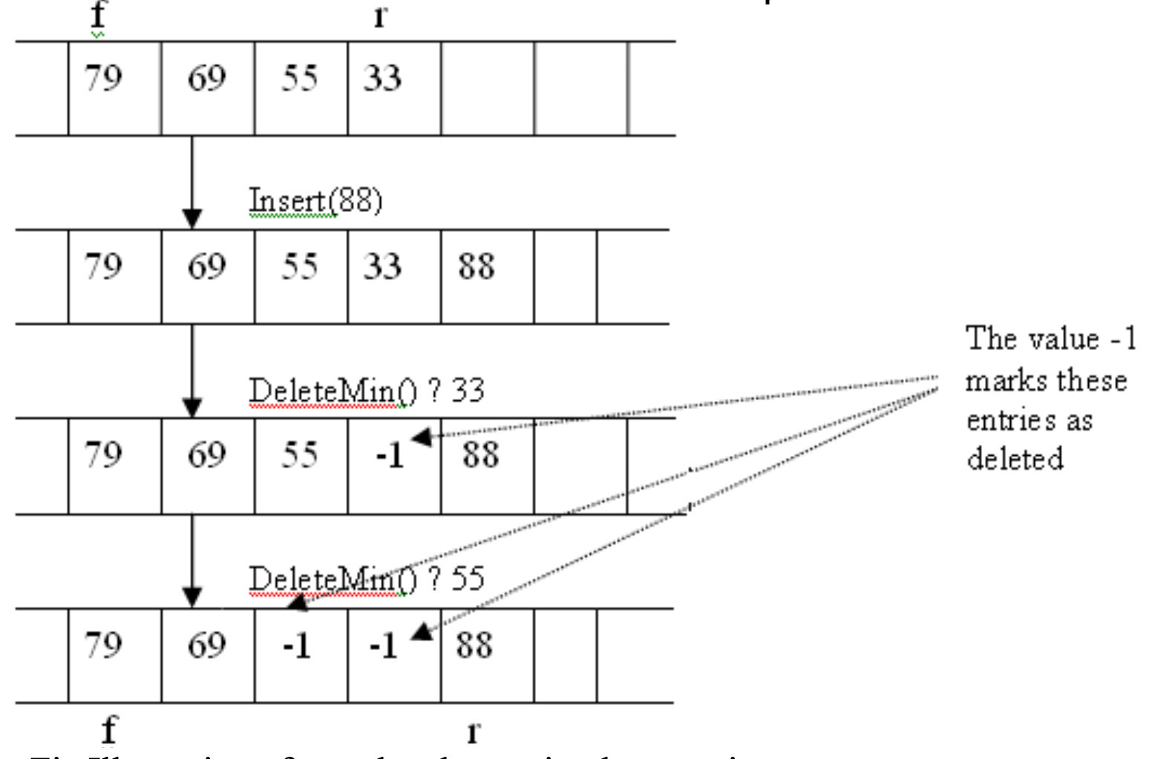
Array implementation of priority queue:
Unordered array implementation:

Slide 26
Array implementation of priority queue:
Ordered array implementation:
Set the front as the position of the smallest element and the rear as the position of the largest element.
To insert an element, locate the proper position of the new element and shift preceding or succeeding elements by one position.
To delete the minimum element, increment the front position.

Slide 27
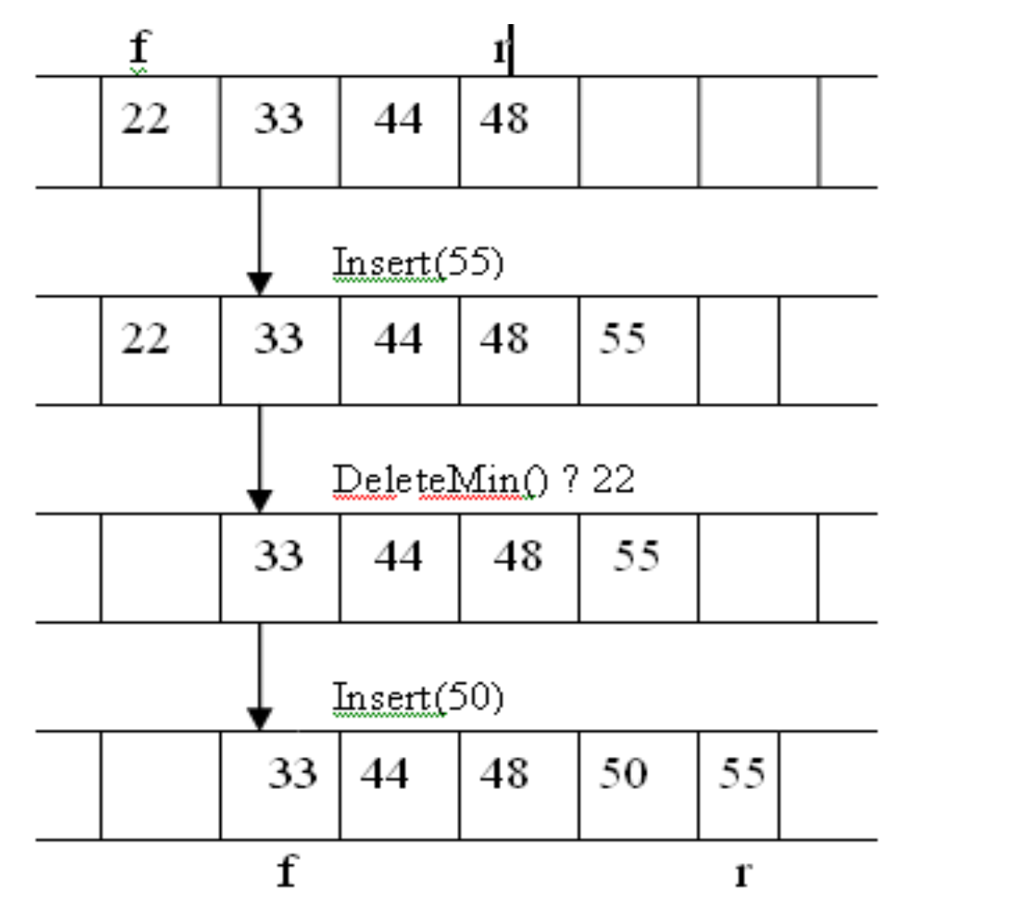
Array implementation of priority queue:
Ordered array implementation:

Slide 28
Priority Queue Operations
Declaration:
Data type of Priority Queue is the same as the Non-priority Queue.
#define MAXQUEUE 10 /* size of the queue items*/ struct pqueue { struct item{ int front; int value; int rear; int priority; struct item items[MAXQUEUE]; } };
struct pqueue *pq;

Slide 29
Priority Queue Operations
Insertion:
The insertion in Priority queues is the same as in non-priority queues.
Deletion :
Deletion requires a search for the element of highest priority and deletes the element with highest priority.
The following methods can be used for deletion/removal from a given Priority Queue:
An empty indicator replaces deleted elements.
After each deletion elements can be moved up in the array decrementing the rear.
The array in the queue can be maintained as an ordered circular array

Slide 30
Applications of Priority Queue
Resource Scheduling algorithm
Sorting of a file
CPU Scheduling algorithm

